Slide 1
Suffrage
Ms. George
Midvale Middle School

Slide 2
What is Suffrage?
Suffrage – The Right to Vote.
In 1789, when the United States Constitution went into effect, only white men who owned land had suffrage, or the right to vote.
Those excluded from voting included:
Poor men who did not own land
Slaves
Native Americans
Women

Slide 3
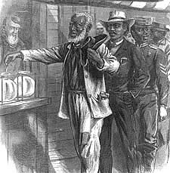
Road to Suffrage
Poor White Men
Poor White Men gained the right to vote in the 1830s.
Slaves
In 1865, the 13th Amendment ended slavery & in 1870, the 15th Amendment gave all men the right to vote regardless of race.
Native Americans
In 1924, President Coolidge signed a bill granting Native Americans citizenship, thus allowing them to vote.

Slide 4
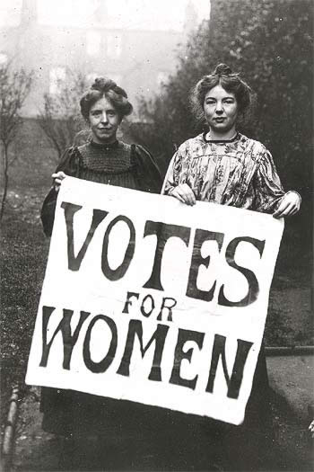
Women’s Suffrage
The fight for women’s suffrage began in 1848 at the Seneca Falls Convention in upstate New York.
Women would continue to fight for almost 80 years more before women would finally get the right to vote.
Finally after years of hard work, the 19th Amendment was added to the Constitution of the United States in 1920.

Slide 5
