Slide 1
Triangle Shirtwaist Factory Fire
Midvale Middle School

Slide 2
Triangle Shirtwaist Factory
The Triangle Shirtwaist Company was located on the eighth, ninth, & tenth floors of the ten-story Asch Building in NYC.
The company employed 500 workers, mostly young immigrant women from Italy and Eastern Europe.
Some workers were as young as eleven and worked fourteen-hour a day, sewing clothes for $1.50 per week (approximately $34 per week in today’s dollars).

Slide 3
Uprising of the 20,000
A few months before the fire, workers throughout NYC had gone on strike to fight for many things, including safer working conditions.
The strike ended when most of the companies in NYC agreed to meet the workers demands. The Triangle Factory was NOT one of these companies. They refused to make any changes.
The women who worked at the Triangle Factory returned to work without any improvements.

Slide 4
Factory Conditions
Flammable textiles were stored throughout the factory.
Scraps of fabric littered the floors.
Patterns and designs on sheets of tissue paper hung above the tables.
Smoking was common.
Light was provided by open gas lighting.
No fire extinguishers.

Slide 5
“Fire, Fire!!”
On March 25, 1911, twenty minutes before quitting time, a fire began on the eighth floor.
Because the factory was covered in patterns and fabric, the fire quickly spread.
The workers on the tenth and eighth floors were alerted and able to evacuate. However the warning about the fire did not reach the ninth floor in time.

Slide 6
The 9th Floor
The ninth floor had only two doors leading out.
One stairwell was already filling with smoke and flames by the time the workers realized their was a fire.
The other door had been locked to prevent workers from stealing materials or taking unauthorized breaks.

Slide 7
Eye Witness
Rosey Safran recalled, “The door was locked and immediately there was a great jam of girls before it. The fire was on the other side, driving us away from the only door that the bosses had left open for us to use. The flames were already blazing fiercely and spreading fast. Some girls were screaming, some were beating the door with their fists, some were trying to tear it open.”
(Hopkinson, Deborah. Shutting out the Sky, 2003, p. 66)
Kate Alterman recalled, “The whole door was a red curtain of fire. I ran out through the Greene Street side door, right through the flames.”
(Hopkinson, Deborah. Shutting out the Sky, 2003, p. 66)

Slide 8
Fire Escape
The single exterior fire escape was a flimsy, poorly-anchored iron structure. It soon twisted and collapsed under the weight of so many girls trying to escape.

Slide 9
No Other Way Out
Panicked workers tried to save themselves by jumping down the elevator shaft to land on the roof of the elevator.
Realizing there was no other way to avoid the flames, 62 women broke the window and jumped to the pavement, nine floors below.

Slide 10
Death Toll
The fallen bodies and falling victims made it difficult for the fire department to reach the building.
The fire department arrived quickly but was unable to stop the flames because the ladders could only reach the sixth floor.
In less then 30 minutes, it was over and 146 young women were dead.

Slide 11
The 9th Floor

Slide 12
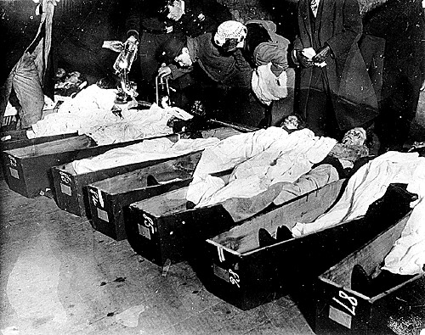
Bodies at the Morgue

Slide 13
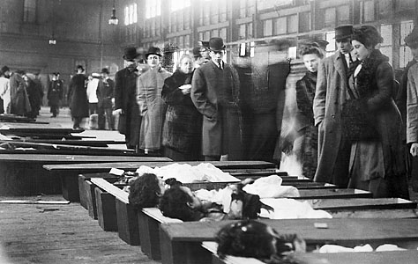
Bodies at the Morgue

Slide 14
Reform comes out of Tragedy
A few months before the fire, workers striking with the Uprising of the 20,000 demanded safer working conditions.
At the time, the public did not think safer working conditions were needed, but after the fire, the public demanded safer working conditions throughout all the factories.
As a direct result of the fire, the government passed several new safety laws, including many on fire prevention.
Triangle Shirtwaist Factory Strikers accomplished in death, what they could not in life.

